Slide 1
Regime Switching How Regimes Affect Asset Allocation
Kun Yu
Luoyi Zou

Slide 2
Introduction

Slide 3
Table of Contents
Regime-Switching Beta Model
Regime-Switching Market Timing model
Out-of-Sample Test of the Model
Conclusion

Slide 4
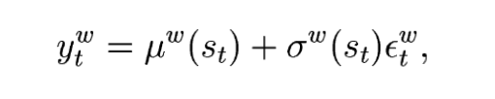
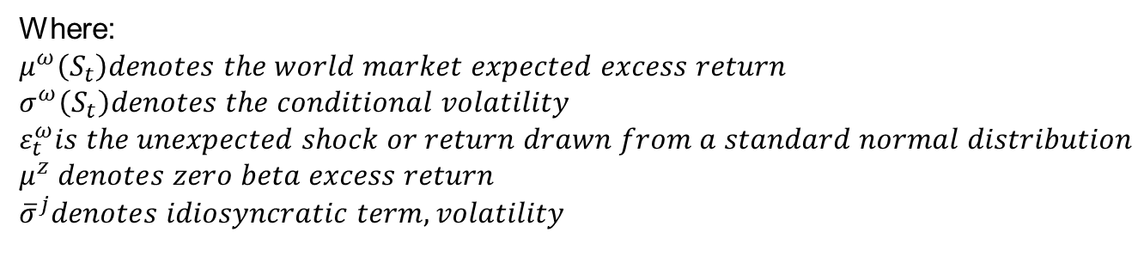
1. Regime-Switching Beta Model
International CAPM model with world market return:
Individual excess return for security j:
Where:
$$μ^{ω}\left(S_{t}\right)denotes the world market expected excess return$$
$$σ^{ω}\left(S_{t}\right)denotes the conditional volatility$$
$$ε_{t}^{ω}is the unexpected shock or return drawn from a standard normal distribution$$
$$μ^{z} denotes zero beta excess return$$
$${\overline{σ}}^{j}denotes idiosyncratic term, volatility$$

Slide 5
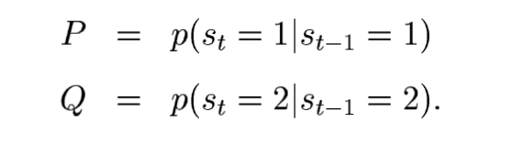
Regime Dynamics
Assume that the portfolio manager knows the realized regime but does not know which regime will be realized next time period.
The regime variable follows a Markov process with constant transition probabilities P and Q:
The situation P =1-Q usually does not happen. Empirical studies (e.g., Gray(1996)) find P and Q are well over 50%, indicating persistent states.

Slide 6
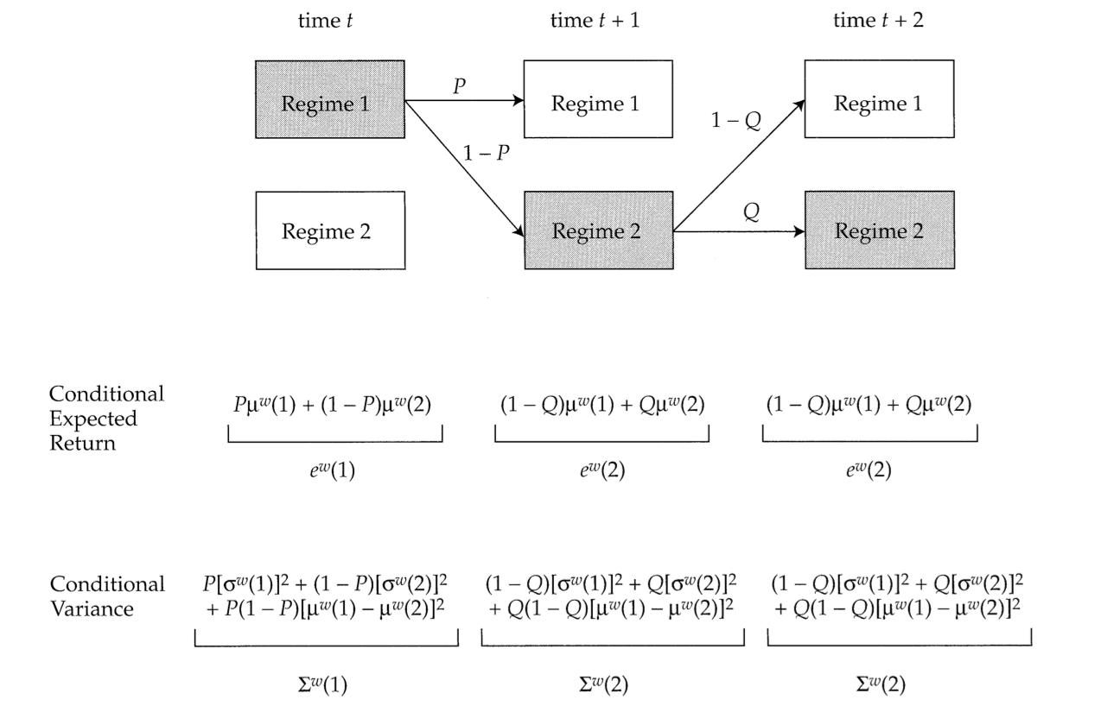
A Regime-Switching Model for the world

Slide 7
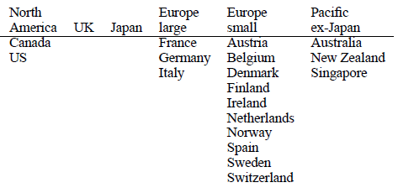
Data
The table lists the country composition of the geographic returns. Within each geographic region, they construct monthly returns, value-weighted in US dollars. The sample period is February 1975 through the end of 2000.

Slide 8
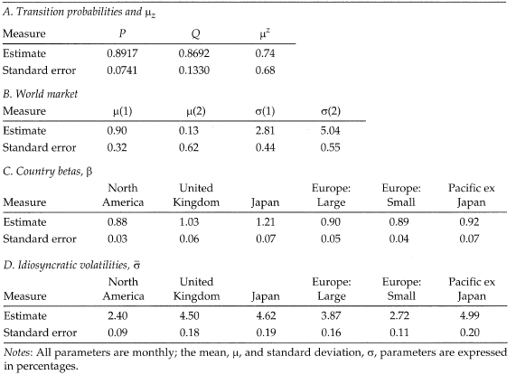
Regime-Switching Beta Model Parameter Estimates

Slide 9
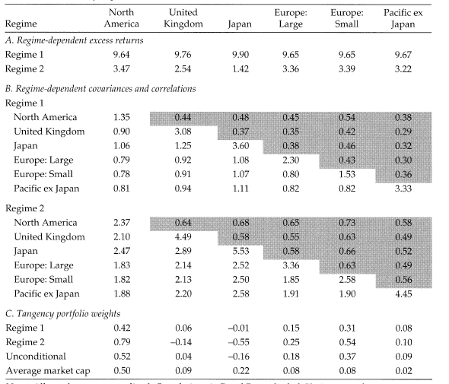
RS Equity Model Estimation Results, 1975-2000

Slide 10
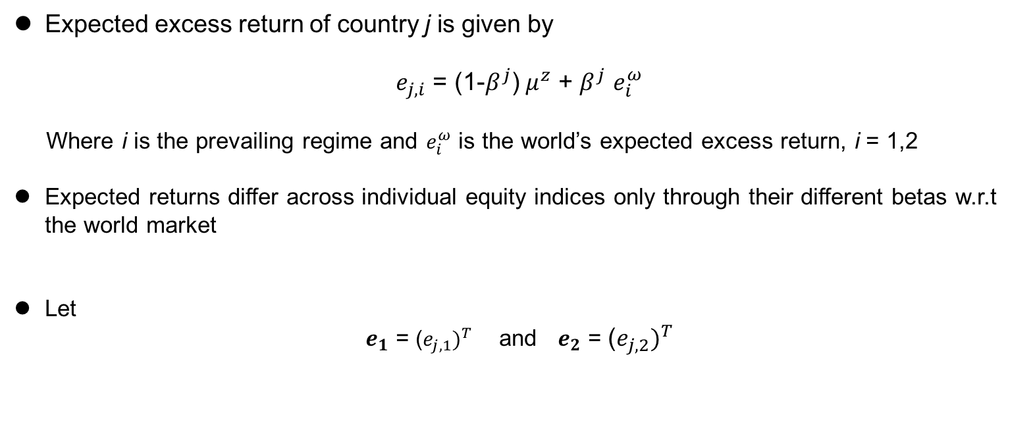
Asset Allocation
Expected excess return of country j is given by
$e_{j,i}$ = (1-$β^{j}$) $μ^{z}$ + $β^{j}$ $e_{i}^{ω}$
Where i is the prevailing regime and $e_{i}^{ω}$ is the world’s expected excess return, i = 1,2
Expected returns differ across individual equity indices only through their different betas w.r.t the world market
Let
$e_{1}$ = ${\text{(}e_{j,1})}^{T}$ and $e_{2}$ = ${\text{(}e_{j,2})}^{T}$

Slide 11
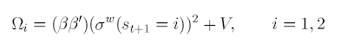
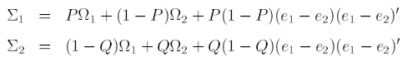
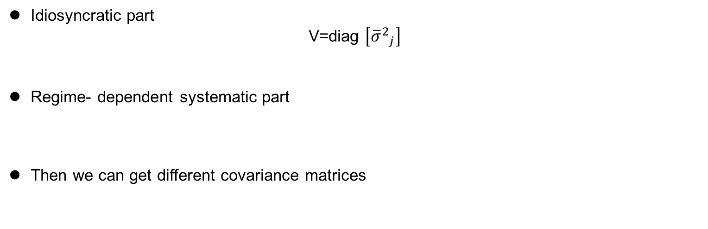
The Covariance Matrix
Idiosyncratic part
V=diag $\left[{{\overline{σ}}^{2}}_{j}\right]$
Regime- dependent systematic part
Then we can get different covariance matrices

Slide 12
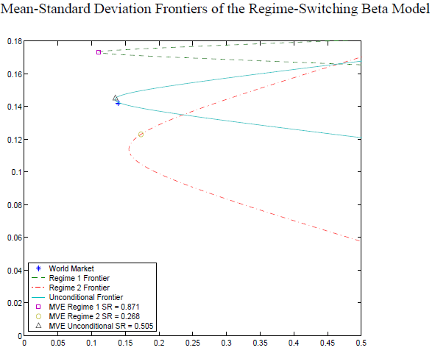
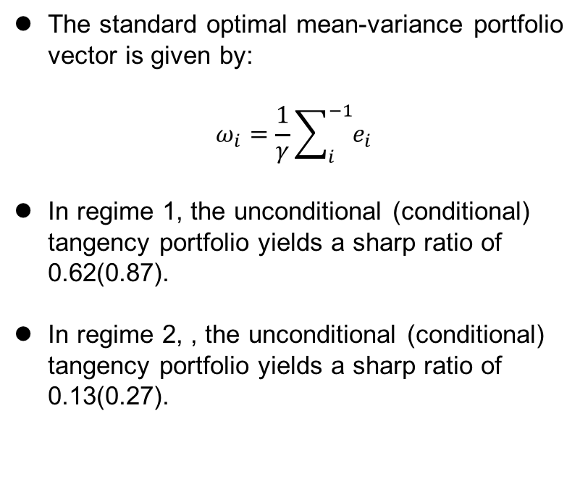
RS Portfolio Strategy Results
The standard optimal mean-variance portfolio vector is given by:
$$ω_{i}=\frac{1}{γ}\sum_{i}^{−1}{e_{i}}$$
In regime 1, the unconditional (conditional) tangency portfolio yields a sharp ratio of 0.62(0.87).
In regime 2, , the unconditional (conditional) tangency portfolio yields a sharp ratio of 0.13(0.27).

Slide 13
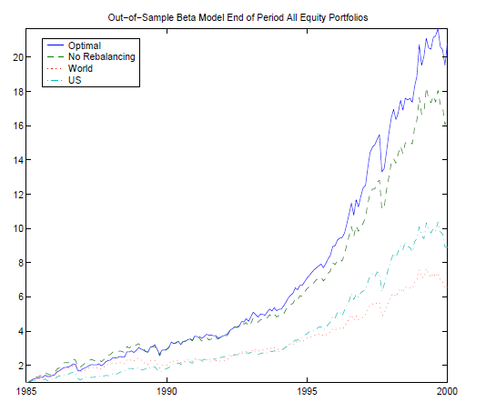
RS Portfolio Strategy Results
The model was rebalanced every month.
The outperformance is particularly striking for the last five years. It is also over the last five years that the RS strategy outperformed the non-regime-dependent strategy particularly successfully.

Slide 14
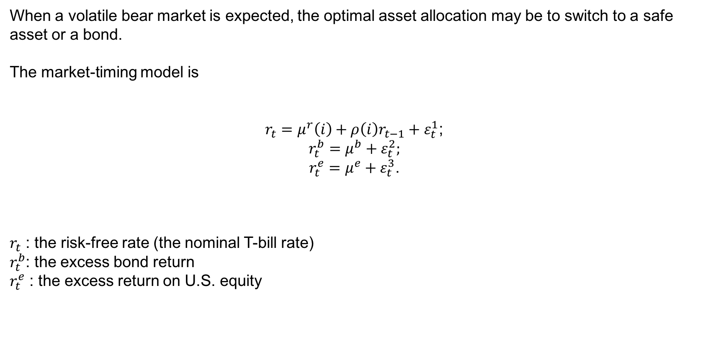
2. Regime Switching Market Timing Model
When a volatile bear market is expected, the optimal asset allocation may be to switch to a safe asset or a bond.
The market-timing model is
$r_{t}=μ^{r}\left(i\right)+ρ\left(i\right)r_{t−1}+ε_{t}^{1}$;
$$r_{t}^{b}=μ^{b}+ε_{t}^{2};$$
$r_{t}^{e}=μ^{e}+ε_{t}^{3}$.
$r_{t}$ : the risk-free rate (the nominal T-bill rate)
$r_{t}^{b}$: the excess bond return
$r_{t}^{e}$ : the excess return on U.S. equity

Slide 15
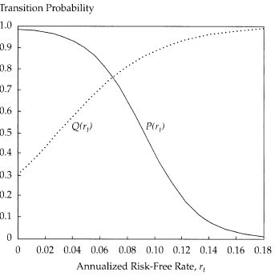
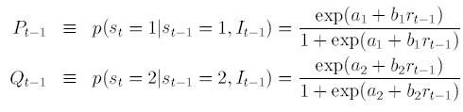
Transition probabilities of the Market Timing Model
Specify the transition probabilities to be a function of the short rate:

Slide 16
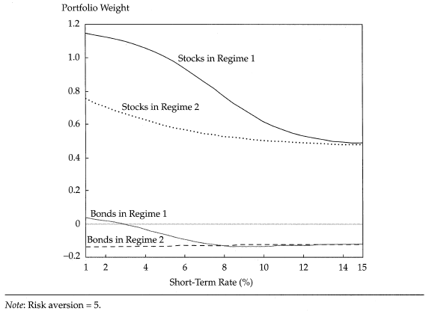
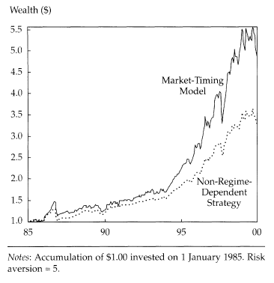
Mean-Variance Market Timing
Asset Allocation of the Market-Timing Model as a Function of the Short Rate
Out-of-Sample Wealth for the Market- Timing Model, 1985-2000

Slide 17
3. Out-of-Sample Test of the Model
Historical Data of 12 Indices Were Used
- JPM US CASH 3MO TOT RET IDX
- MSCI Japan Index
- S&P500 Index
- JPM EMBI GLOBAL COMPOSITE
- Swiss Performance Index
- MSCI North America Index
- MSCI EMU Index
- MSCI UK Index
- MSCI Paficic Index
- MSCI EM Index
- MSCI World Index
Source: BenchmarkReturns_v2.xlsx, Bloomberg

Slide 18
Out-of-Sample Test - The Process
First Estimation:
Probabilities
Parameters
Weights
Rebalance Portfolio
1994
50-Month
Window
1998
2017
Estimations in Following Months

Slide 19
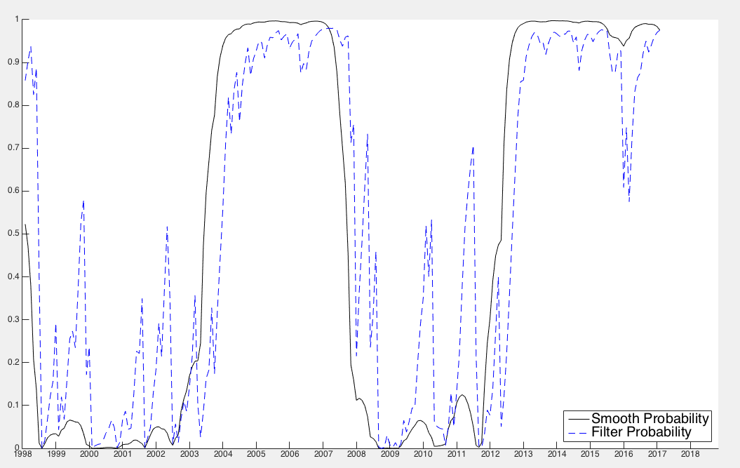
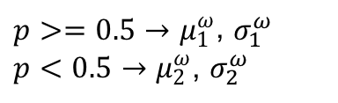
Ex-Ante and Smoothed Probabilities: Being in Regime 1
$p>=0.5→μ_{1}^{ω}$, $σ_{1}^{ω}$
${p<0.5→μ}_{2}^{ω}$, $σ_{2}^{ω}$
We calculate the expected returns and conditional volatilities of each markets using the estimated world expected returns and volatilities of regime 1, provided that the current state is more likely to be in regime 1 (p>0.5), and vice versa.

Slide 20
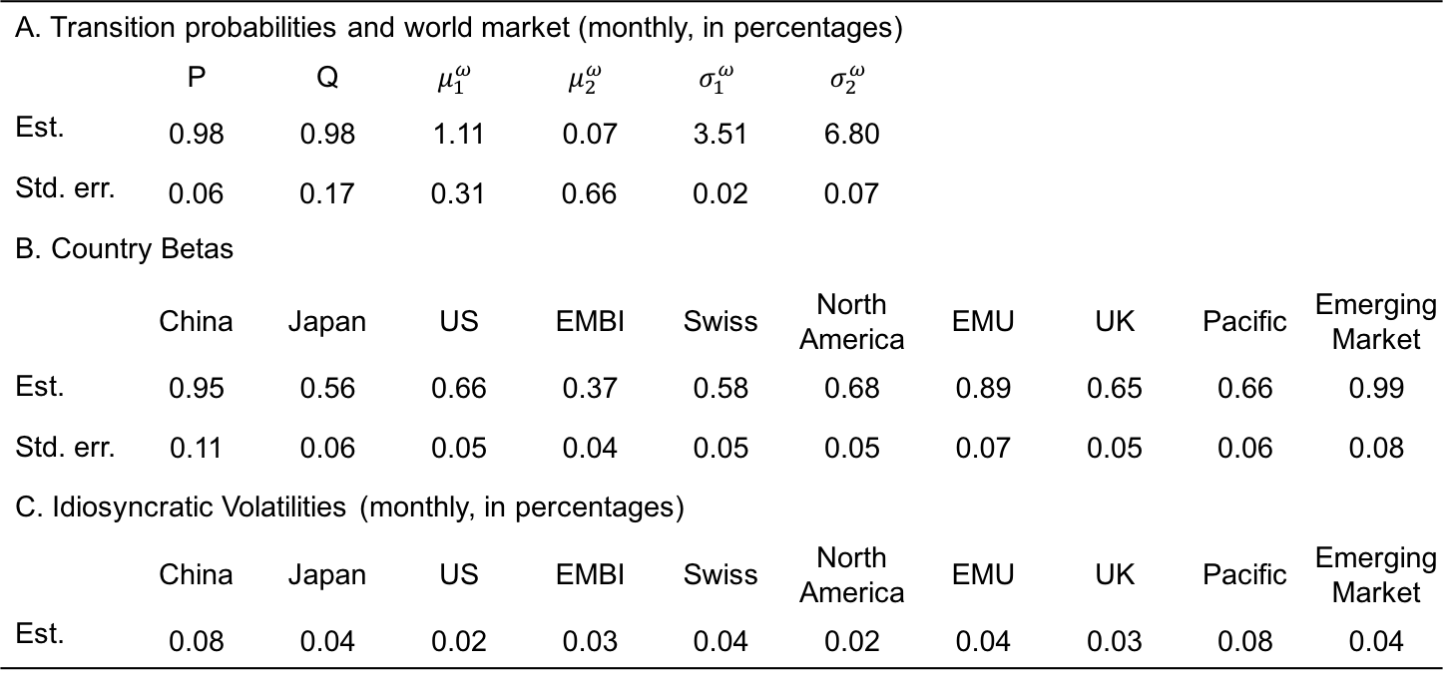
Estimation Results: 1994 - 2017
A. Transition probabilities and world market (monthly, in percentages)
 | P | Q | $$μ_{1}^{ω}$$ | $$μ_{2}^{ω}$$ | $$σ_{1}^{ω}$$ | $$σ_{2}^{ω}$$
Est. | 0.98 | 0.98 | 1.11 | 0.07 | 3.51 | 6.80
Std. err. | 0.06 | 0.17 | 0.31 | 0.66 | 0.02 | 0.07
B. Country Betas
 | China | Japan | US | EMBI | Swiss | North America | EMU | UK | Pacific | Emerging Market
Est. | 0.95 | 0.56 | 0.66 | 0.37 | 0.58 | 0.68 | 0.89 | 0.65 | 0.66 | 0.99
Std. err. | 0.11 | 0.06 | 0.05 | 0.04 | 0.05 | 0.05 | 0.07 | 0.05 | 0.06 | 0.08
C. Idiosyncratic Volatilities (monthly, in percentages)
 | China | Japan | US | EMBI | Swiss | North America | EMU | UK | Pacific | Emerging Market
Est. | 0.08 | 0.04 | 0.02 | 0.03 | 0.04 | 0.02 | 0.04 | 0.03 | 0.08 | 0.04

Slide 21
Covariance and Correlation Matrices & Portfolio Weights
MSCI Indices | China | Japan | US (SPX) | EMB JPM | CH (SPI) | N. Am | EU | UK | Pacific | EM
Regime-dependent Covariance and Correlation Matrices Under Different Regimes
Regime 1 avg. corr. = 0.2660 | 1.05 | 0.12 | 0.16 | 0.13 | 0.13 | 0.16 | 0.16 | 0.15 | 0.14 | 0.16
 | 0.07 | 0.31 | 0.19 | 0.14 | 0.14 | 0.18 | 0.16 | 0.18 | 0.16 | 0.17
 | 0.08 | 0.05 | 0.23 | 0.16 | 0.20 | 0.26 | 0.25 | 0.25 | 0.22 | 0.22
 | 0.05 | 0.03 | 0.03 | 0.15 | 0.15 | 0.16 | 0.16 | 0.15 | 0.14 | 0.17
 | 0.07 | 0.04 | 0.05 | 0.03 | 0.26 | 0.20 | 0.21 | 0.19 | 0.18 | 0.18
 | 0.08 | 0.05 | 0.06 | 0.03 | 0.05 | 0.24 | 0.25 | 0.24 | 0.22 | 0.25
 | 0.11 | 0.06 | 0.08 | 0.04 | 0.07 | 0.08 | 0.44 | 0.21 | 0.22 | 0.22
 | 0.08 | 0.05 | 0.06 | 0.03 | 0.05 | 0.06 | 0.07 | 0.26 | 0.21 | 0.21
 | 0.08 | 0.05 | 0.06 | 0.03 | 0.05 | 0.06 | 0.08 | 0.06 | 0.31 | 0.19
 | 0.12 | 0.07 | 0.08 | 0.05 | 0.07 | 0.09 | 0.11 | 0.08 | 0.08 | 0.56
Regime 2 avg. corr. = 0.6772 | 1.34 | 0.42 | 0.57 | 0.40 | 0.48 | 0.58 | 0.56 | 0.54 | 0.51 | 0.56
 | 0.24 | 0.41 | 0.64 | 0.42 | 0.53 | 0.62 | 0.62 | 0.60 | 0.55 | 0.60
 | 0.28 | 0.17 | 0.38 | 0.59 | 0.70 | 0.85 | 0.82 | 0.78 | 0.75 | 0.84
 | 0.16 | 0.09 | 0.11 | 0.19 | 0.51 | 0.58 | 0.58 | 0.56 | 0.51 | 0.59
 | 0.25 | 0.15 | 0.17 | 0.10 | 0.37 | 0.72 | 0.68 | 0.65 | 0.60 | 0.68
 | 0.29 | 0.17 | 0.20 | 0.11 | 0.18 | 0.39 | 0.83 | 0.80 | 0.73 | 0.82
 | 0.38 | 0.23 | 0.26 | 0.15 | 0.23 | 0.27 | 0.70 | 0.77 | 0.73 | 0.81
 | 0.28 | 0.17 | 0.19 | 0.11 | 0.17 | 0.20 | 0.26 | 0.40 | 0.70 | 0.76
 | 0.29 | 0.17 | 0.20 | 0.11 | 0.17 | 0.20 | 0.27 | 0.20 | 0.45 | 0.72
 | 0.43 | 0.25 | 0.30 | 0.17 | 0.26 | 0.30 | 0.40 | 0.29 | 0.30 | 0.88
Tangency Portfolio Weights
Regime 1 | 0.0315 | 0.0837 | 0.1356 | 0.1448 | 0.1045 | 0.133 | 0.0835 | 0.1165 | 0.0978 | 0.069
Regime 2 | -0.0437 | 0.1385 | 0.1022 | 0.5899 | 0.1595 | 0.0825 | -0.0831 | 0.0984 | 0.0681 | -0.1123
Unconditional | 0 | 0 | 0.0004 | 0.5718 | 0.1958 | 0.2313 | 0.0002 | 0.0002 | 0.0002 | 0

Slide 22
Out-of-Sample Wealth for Various Markets or Strategies, 1998-2017
 | World | RS Strategy | Non-RS Strategy* | Swiss SPI | US SP500
Return | 10.34% | 9.91% | 7.48% | 7.80% | 5.79%
Volatility | 18.98% | 19.22% | 15.31% | 16.61% | 15.19%
Max Draw- down | 53.12% | 45.61% | 48.85% | 44.70% | 50.48%
Sharpe Ratio | 0.51 | 0.44 | 0.40 | 0.38 | 0.29
*Non-Regime-Dependent Strategy: Out-of-sample, monthly rebalancing, with short-sell constraint

Slide 23
Conclusion
Equity returns perform badly and were highly correlated during high-volatility period.
Changes between low- and high-volatility regimes can help to add value to portfolios.
RS models are very valuable in tactical asset allocation programs that allow switching to a risk-free asset.
The results in RS strategy are highly linked to historical period
Further studies
build a Black-Litterman (1992) type equilibrium into the regime-switching model and into
the estimation of the parameters
test whether there are country specific regimes

Slide 24
References
[1] Ang A, Bekaert G. How do regimes affect asset allocation?[R]. National Bureau of Economic
Research, 2003.
[2] Ang A, Bekaert G. International asset allocation with regime shifts[J]. Review of Financial studies, 2002, 15(4): 1137-1187.
[3] Perlin M. MS_Regress-the MATLAB package for Markov regime switching models[J]. 2015.
[4] Jensen M C, Black F, Scholes M S. The capital asset pricing model: Some empirical tests[J]. 1972.
[5] Gray S F. Modeling the conditional distribution of interest rates as a regime-switching process[J]. Journal of Financial Economics, 1996, 42(1): 27-62.
[6] Markus Leippold, 2017, “Regime Switching”, Asset Management: Advanced Investments lecture notes

